Slide 1

Python Course Chapter 17
Other Topics

Slide 2
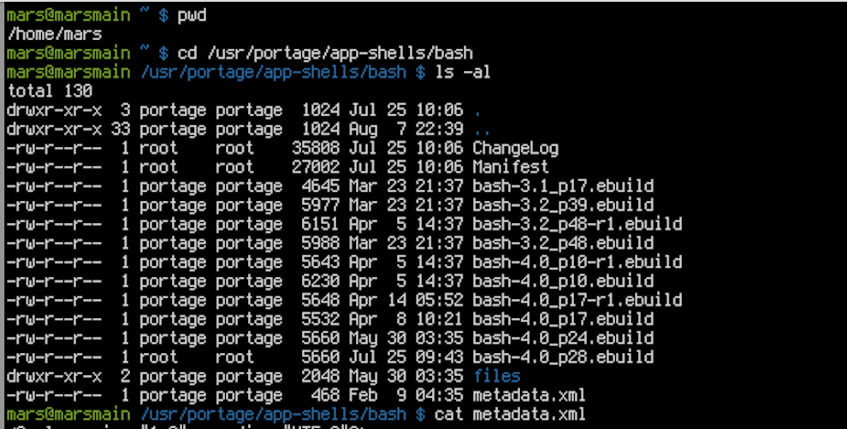
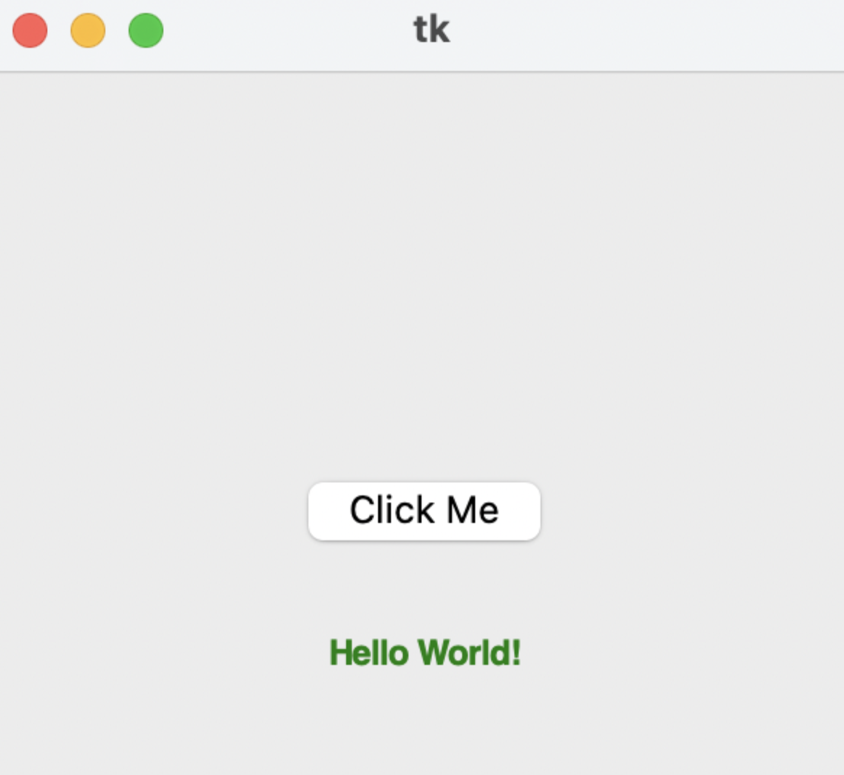
Tkinter
Tkinter is in Python standard library to create Graphical User interfaces (GUIs) and is included in all standard Python Distributions. We can use Tkinter to make desktop applications.
Traditionally, computers only have a command-line interface (CLI). The invention of the graphical user interface (GUI) makes computers a lot easier to learn and use.

Slide 3
Flask
Many programming languages can be used to write server-side scripts. For example, JavaScript has Node.js and Express.js, Java has HTTPServer, and C++ has Treefrog.
Flask is a web framework in Python that lets us develop web applications easily. It also includes functionalities such as URL routing and template engine. Another prevalent Python web framework is Django.
To use flask, we first need to do:
pip install flask

